Slide 1
Input and Output
Rajasekaran S
Assistant Professor,
Department of Information Technology,
KGiSL Institute of Technology,
email: proffraja@gmail.com
Github:www.github.com/rajasekaranap

Slide 2
Input and Output
Java supports I/O operations for the verity of source and destinations.
It contain java.io package that has all classes for I/O operations.

Slide 3
Streams
Stream is a sequence of data.
It can be obtained from a specific source.
It is processed by the program to obtain desired results.
1 | 0 | 1 | 1 | 1 | 0 | 0 | 0 | 1 | 1

Slide 4
Types of Streams
Streams
Input Stream
Output Streams
Standard Streams

Slide 5
Standard Streams
Standard Streams
System.out
System.err
System.in

Slide 6
Types of Stream Based of Data Handling
Streams
Byte Stream
Character Stream

Slide 7
Byte Streams
Byte streams process data byte by byte (8 bits)
Suitable to perform reading and writing in binary files.
Eg:
FileInputStream
FileOutputStream

Slide 8
OutputStream vs InputStream

Slide 9
OutputStream vs InputStream
OutputStream
It is an abstract class.
It helps to write a data to the destination.
It is the superclass of all classes representing an output stream of bytes.
InputStream
It is an abstract class.
It helps to read a data to the source.
It is the superclass of all classes representing an input stream of bytes.

Slide 10
OutputStream Methods
Method | Description
1) public void write(int)throws IOException | is used to write a byte to the current output stream.
2) public void write(byte[])throws IOException | is used to write an array of byte to the current output stream.
3) public void flush()throws IOException | flushes the current output stream.
4) public void close()throws IOException | is used to close the current output stream.

Slide 11
Output Stream

Slide 12
InputStream
Method | Description
1) public abstract int read()throws IOException | reads the next byte of data from the input stream. It returns -1 at the end of the file.
2) public int available()throws IOException | returns an estimate of the number of bytes that can be read from the current input stream.
3) public void close()throws IOException | is used to close the current input stream.

Slide 13
InputStream

Slide 14
Character Streams
In Java, characters are stored using Unicode conventions.
Character stream automatically allows us to read/write data character by character.
Suitable to perform reading and writing in text files.
It process 16 bit [standard for unicode character] per operation[read/write].
Eg:
FileReader
FileWriter
BufferedReader
BufferedWriter

Slide 15
Reading from Console
Read Console
Using
Scanner Class
Using
Buffered Reader
Using Console

Slide 16
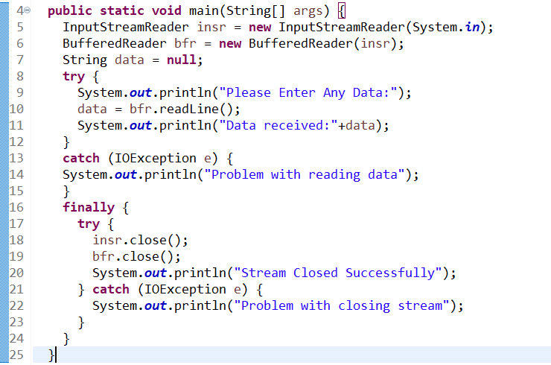
Using BufferedReader

Slide 17
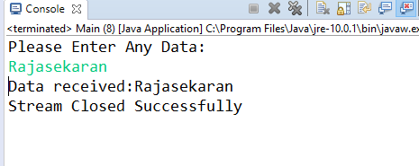
Output

Slide 18
Console Class for I/O
The Java.io.Console class provides methods to access the character-based console device, if any, associated with the current Java virtual machine.
The Console class was added to java.io by JDK 6.

Slide 19
Importance of Console
It is used to read from and write to the console, if one exists.
Console is primarily a convenience class because most of its functionality is available through System.in and System.out.
Console supplies no constructors. Instead, a Console object is obtained by calling System.console( ).
It provides methods to read text and password. If you read password using Console class, it will not be displayed to the user.
The java.io.Console class is attached with system console internally.

Slide 20
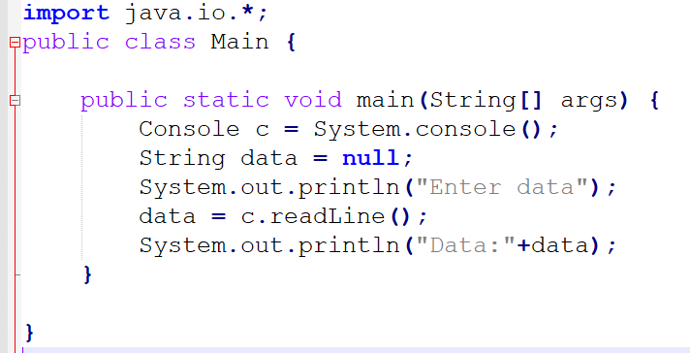
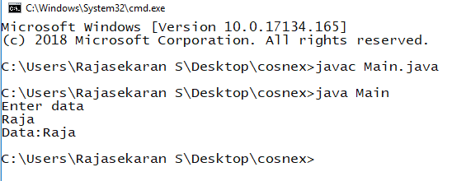
Using Console
Console Class
Read User Input

Slide 21
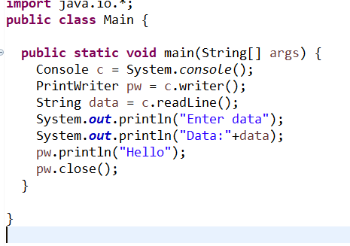
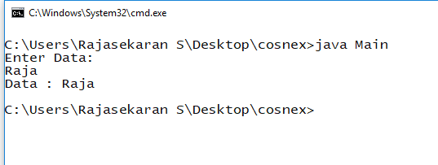
Writing data to console
Getting Writer
Writing data

Slide 22
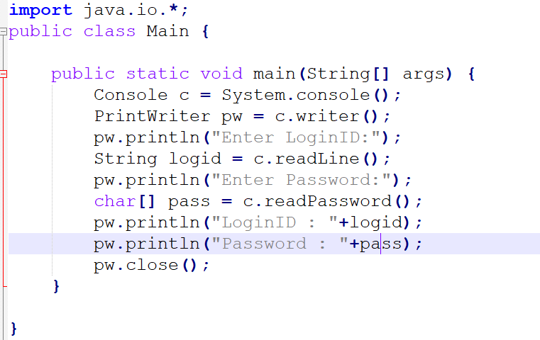
Reading Passwords

Slide 23
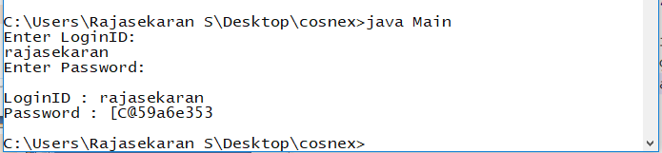
Output

Slide 24
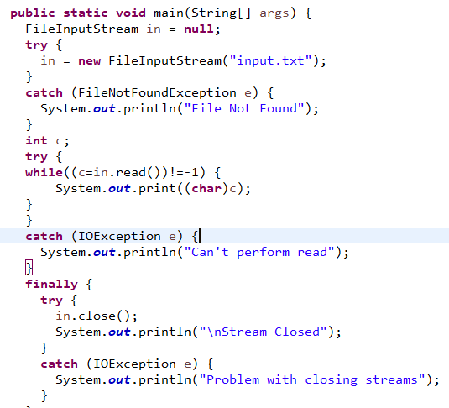
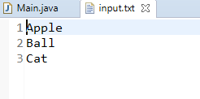
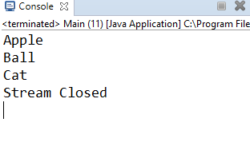
Reading data from file

Slide 25
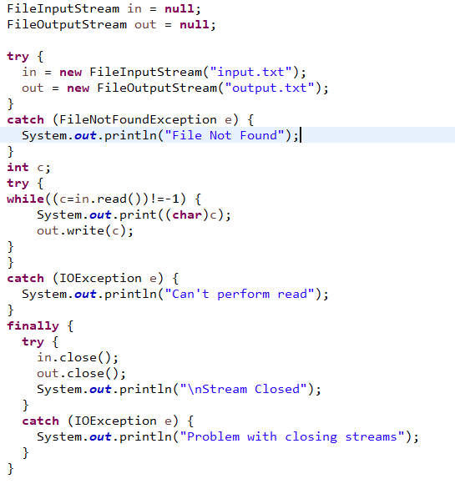
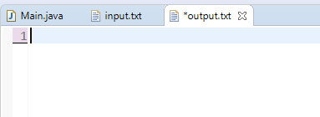
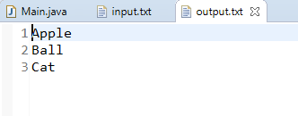
Writing data to file

Slide 26
Thank You
Rajasekaran S
Assistant Professor,
Department of Information Technology,
KGiSL Institute of Technology,
email: proffraja@gmail.com
Github:www.github.com/rajasekaranap

